Slide 1
PRESENTATION OF SCRAPY PROJECT
The project based on collecting IT advertised job in East Africa
https://www.brightermonday.com/

Slide 2
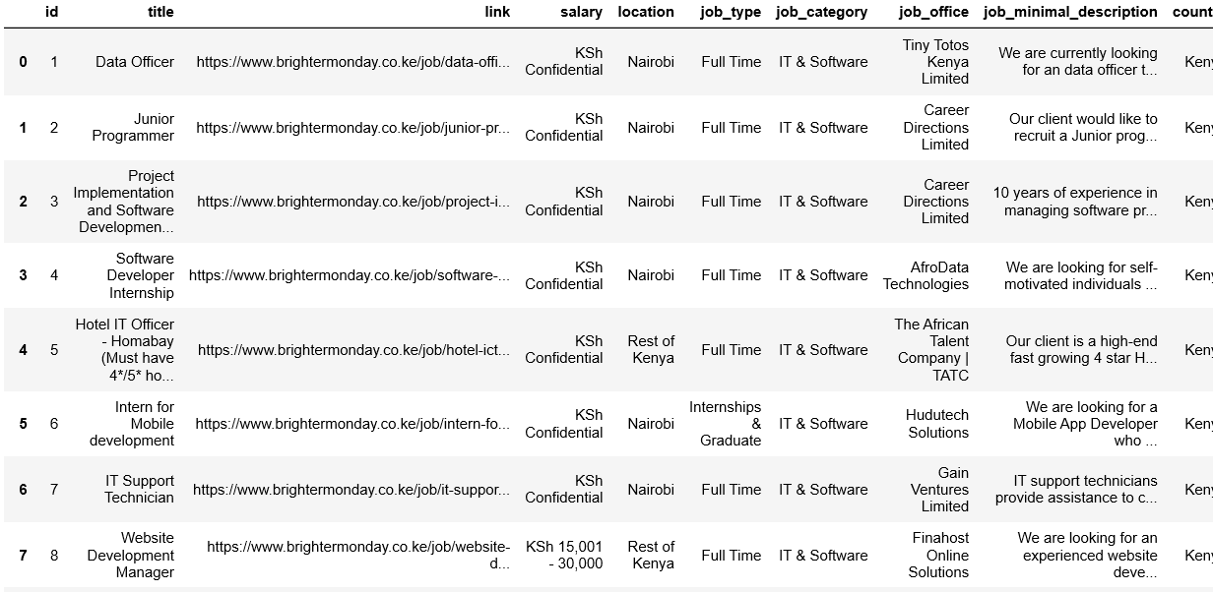
IT job advertisement in East Africa country

Slide 3
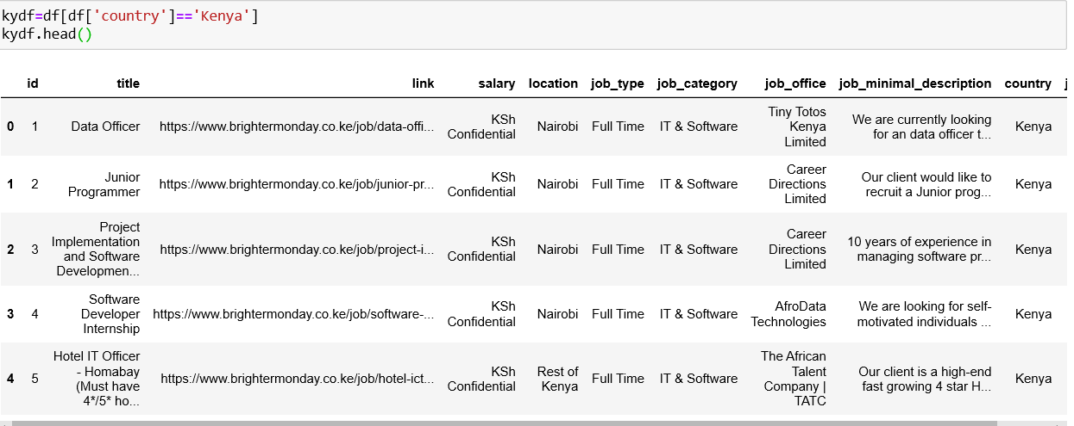
IT job advertisement in kenya

Slide 4
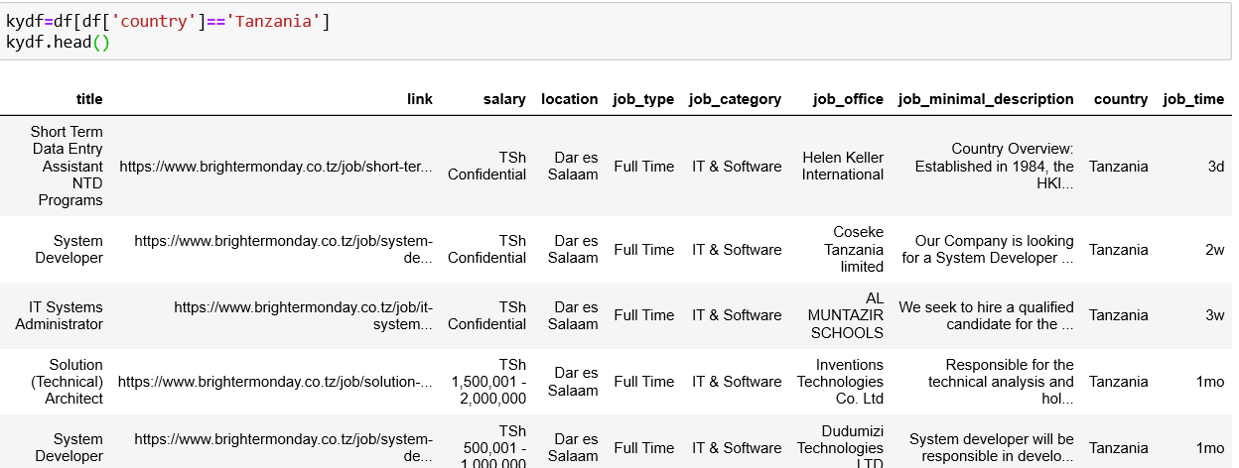
IT job advertisement in Tanzania

Slide 5
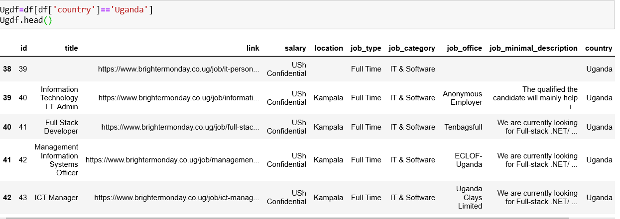
IT job advertisement in Uganda

Slide 6
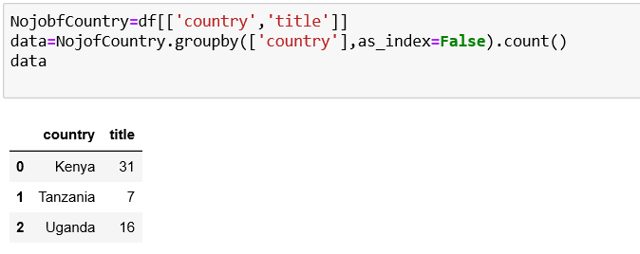
Number of IT job advertised in each country

Slide 7
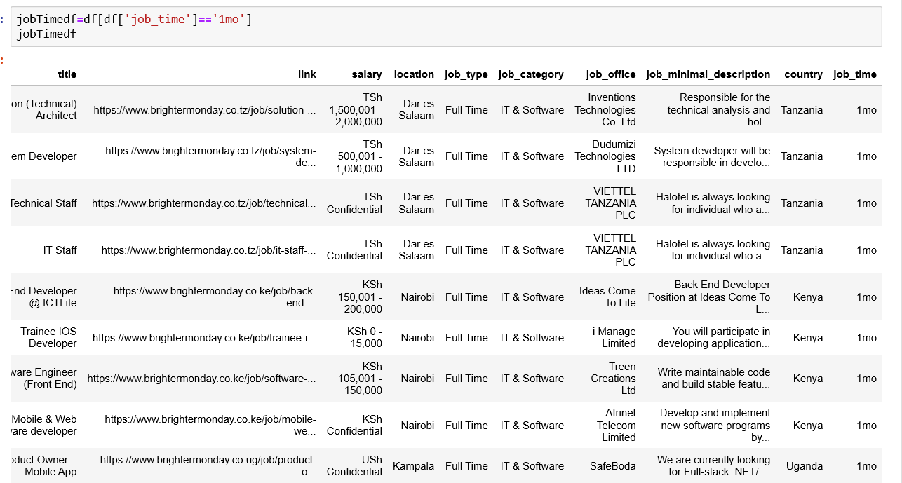
IT job advertised in one month

Slide 8
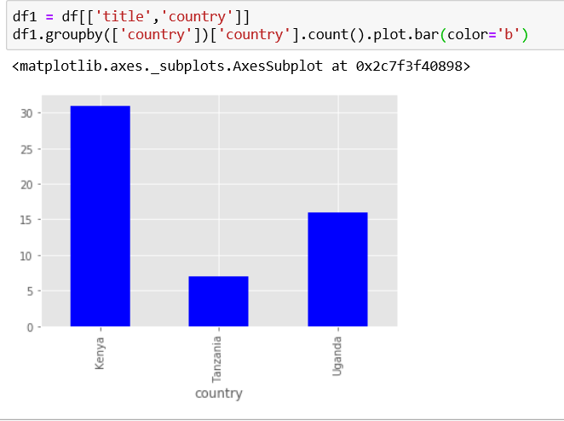
Diagram presentation of number of job present for now in each country

Slide 9
THANKS YOU FOR LISTEN

